Slide 1
Function Overloading And Templates
chp2 p108-110

Slide 2
Function overloading
Function overloading is a feature of C++ that allows many functions with same name but with different signatures (i.e., different parameter list)
Overloaded functions are differentiated based on
Different number of parameters
Different type of parameter(s)
Return Type may or may not be different

Slide 3
Example
Function that returns larger of two values
int largerInt(int x, int y);
If we need the same functionality for other data types, then we have to define other functions as well but with same name

Slide 4
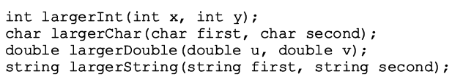

Slide 5
Function Overloading
The only benefit is that same name can be used for different functions
We still have to define all the functions

Slide 6
TEMPLATE

Slide 7
Template
Template concept can be applied to functions as well as classes
Template functions
Template Classes

Slide 8
Template Functions
Templates allows programmers to write a SINGLE functions for a set of related functions
Lets take the same example

Slide 10
Template Function
A template function will always start with a line as:
template <class Type>
OR
template <typename Type>
keyword class or typename can be used interchangeably

Slide 11
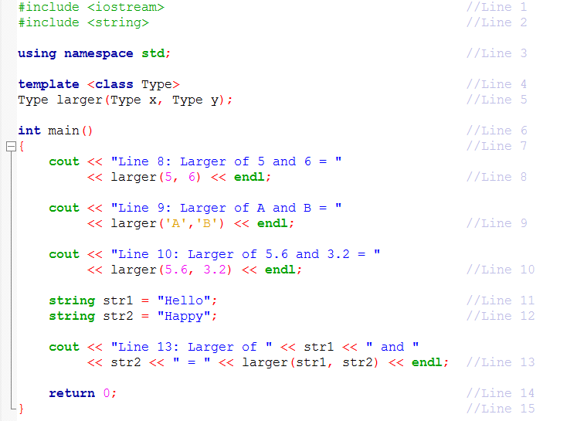
Example 2.7

Slide 12
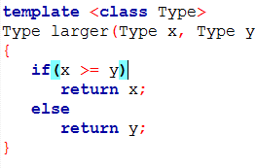
Example 2.7

Slide 13
Exercise
Make a template function, which should swap the values of the parameters
void swap( &val1, &val2)
{
}
main( ){
float a=3.4, b=5.5;
swap(a, b)

Slide 14
Exercise
Create a template function
T largest(array, arraylength)

Slide 15
Template Classes
chp2, p111-112

Slide 16
template classes
Write a single code segment for a set of related classes
Same template line before class definition as used in template functions
There is a slight change to making an object of a template class
class_name<data_type> object_name;

Slide 17
Template Class Example
As you know that there is no check on an array if index is out of bounds
During program execution, an array index out of bounds can cause serious problems
Design and implement the class myArray that solves the array index out of bounds problem

Slide 18
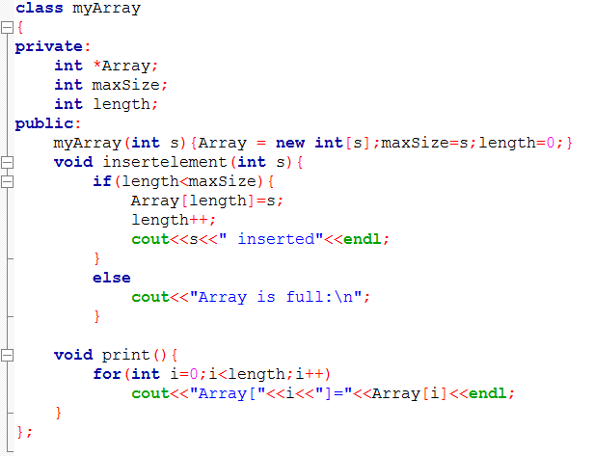
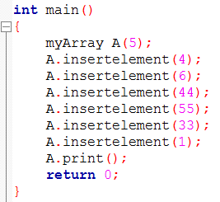

Slide 19
Template Class
Previous example only works for integer array
For every other type of array, we need one class for each type
Making it template is the best way to move on
Modify myArray class to be a template class

Slide 20
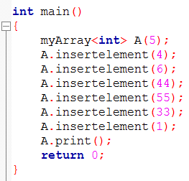
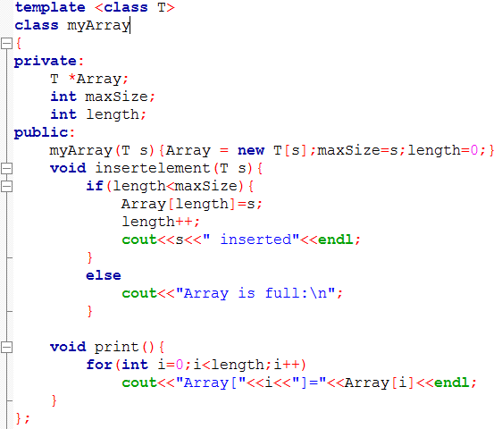
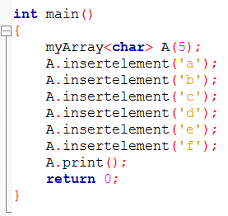

Slide 21
Link List
If a program needs to store some float numbers, some strings, and some integers separately, then will this class FloatList will be sufficient ??

Slide 22
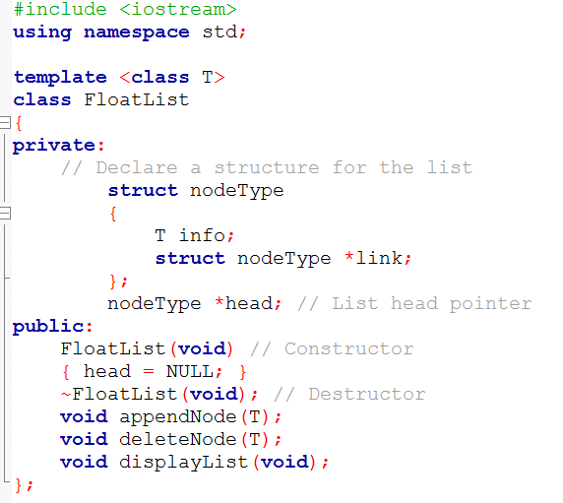
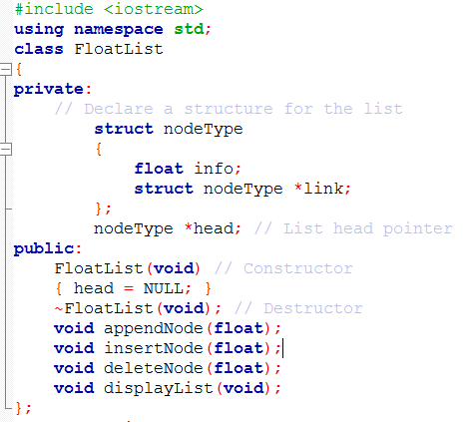
Template Link List class

Slide 23
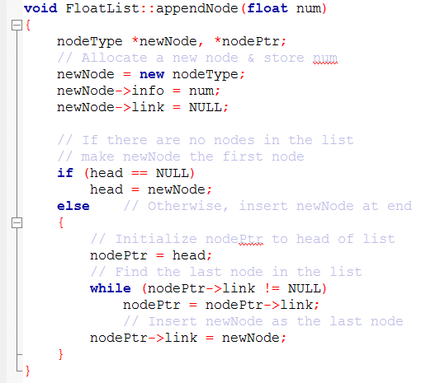
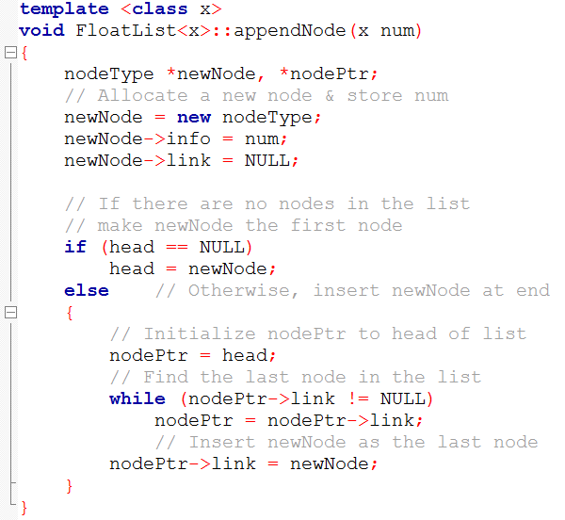
Member function

Slide 24
Link list of class objects
Many times we need to store many objects of some classes.
Here we will create a link list of such objects.
What change we need to do to accommodate objects in the link list??

Slide 25
What should be done to accommodate the link list of Distance objects
class Distance
{
int feet;
int inches;
}

